Slide 1
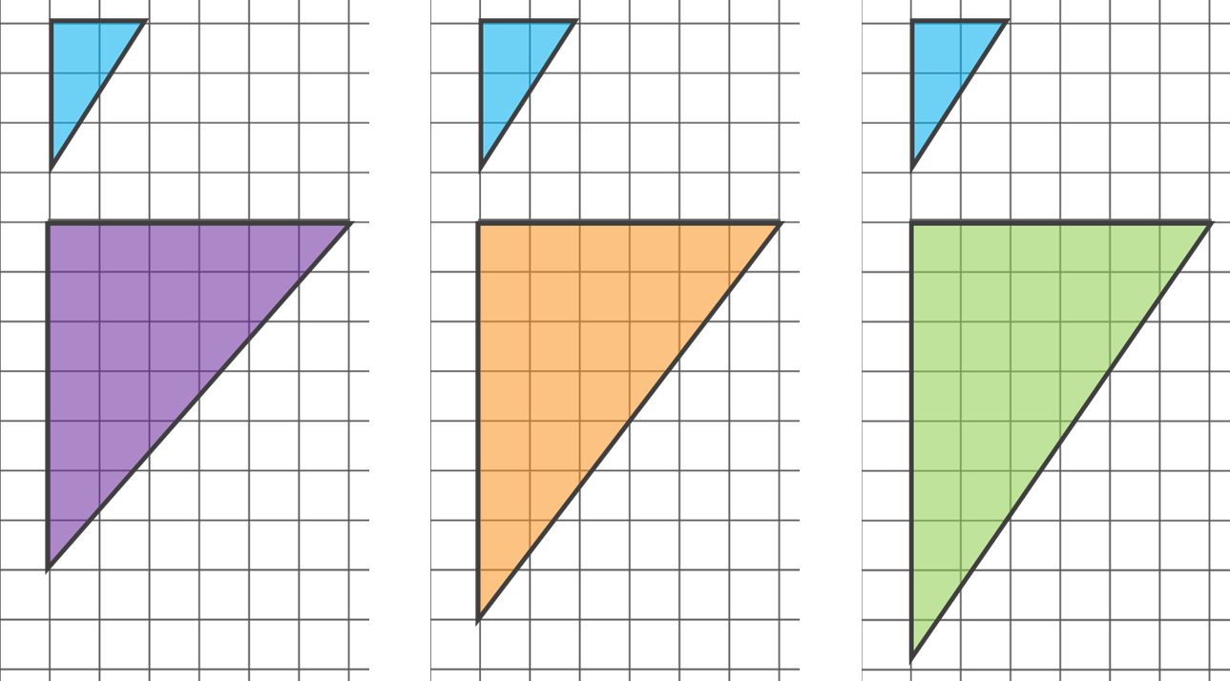
Describing an enlargement
Task A: Using and finding scale factors
1. Parallelogram P has been enlarged to create A, B, C and D. Calculate the missing lengths on each parallelogram.
8 cm
9 cm
P
6 cm
B
3 cm
C
2 cm
_
_
20 cm
18 cm
A
D
_
_
2. Tick the diagram that shows a correct enlargement of the small triangle.
Sam draws another enlargement of the small triangle. One of the lengths is 12 cm. What could the other length be?

Slide 2
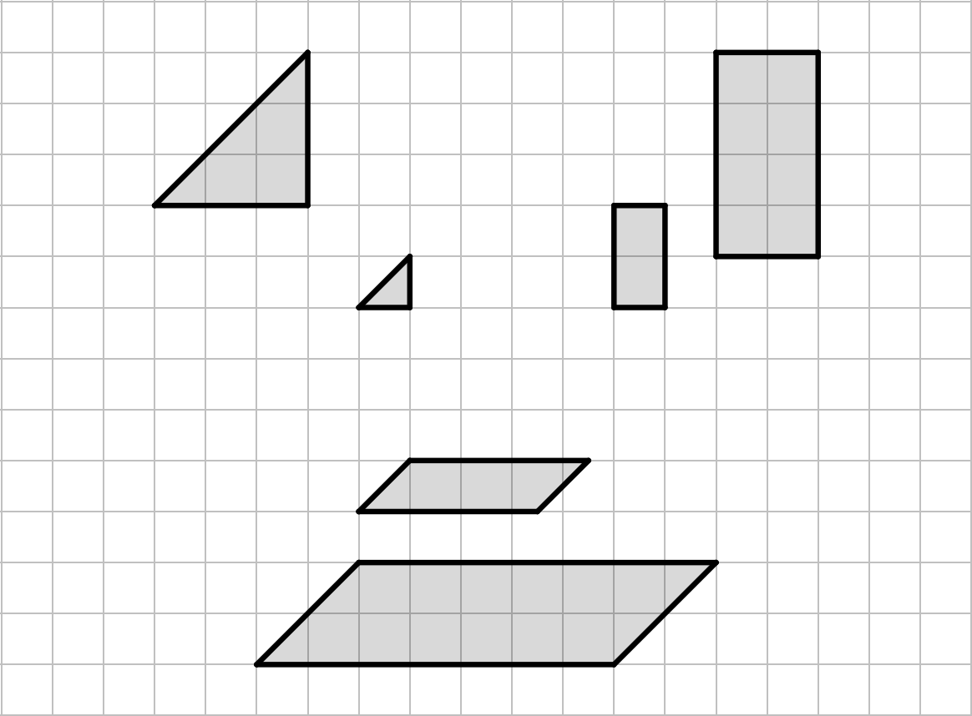
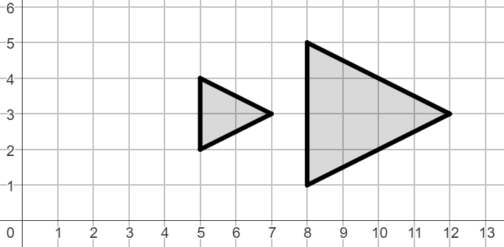
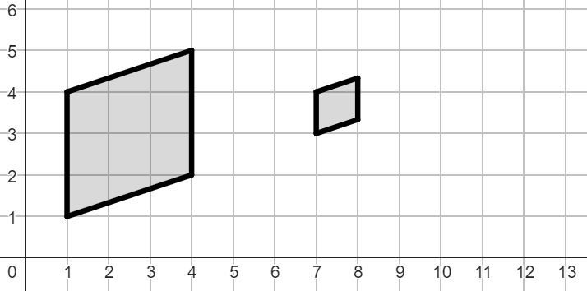
Describing an enlargement
Task B: How the centre of enlargement affects the image
1. Tick the enlargements that have the same centre of enlargement.
A to A′
B to B′
C to C′
A′
B′
A
B
C′
C
2. Describe each transformation fully.
a) A to A′
b) B to B′
A
B′
A′
B
Mathematics in Education and Industry
v2.1

